Slide 1
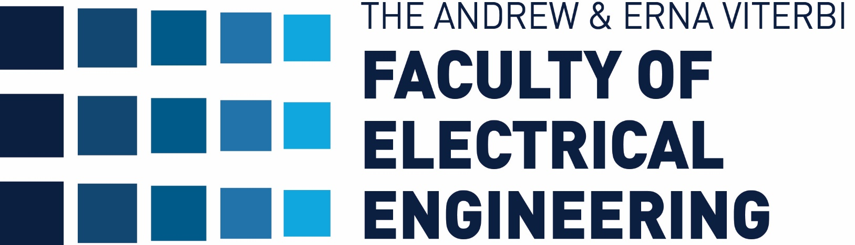


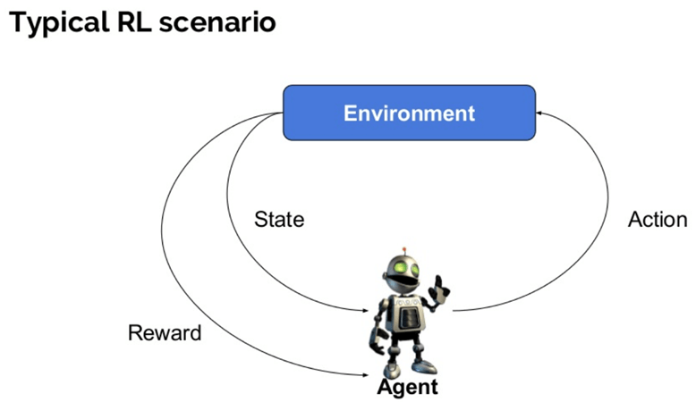
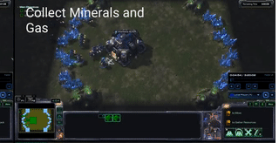
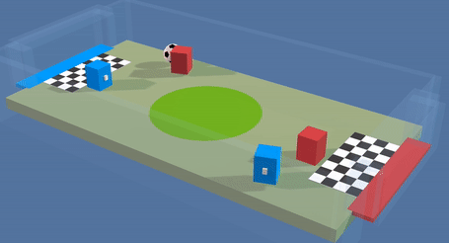
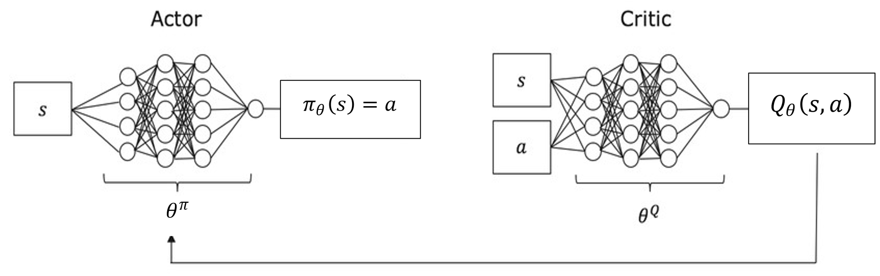
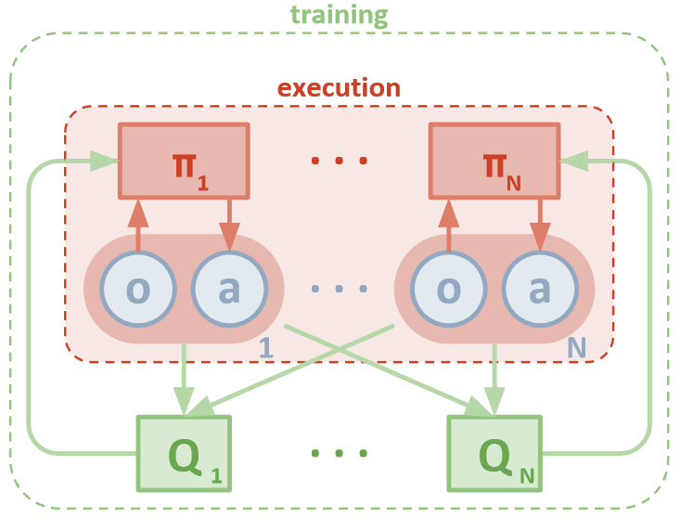
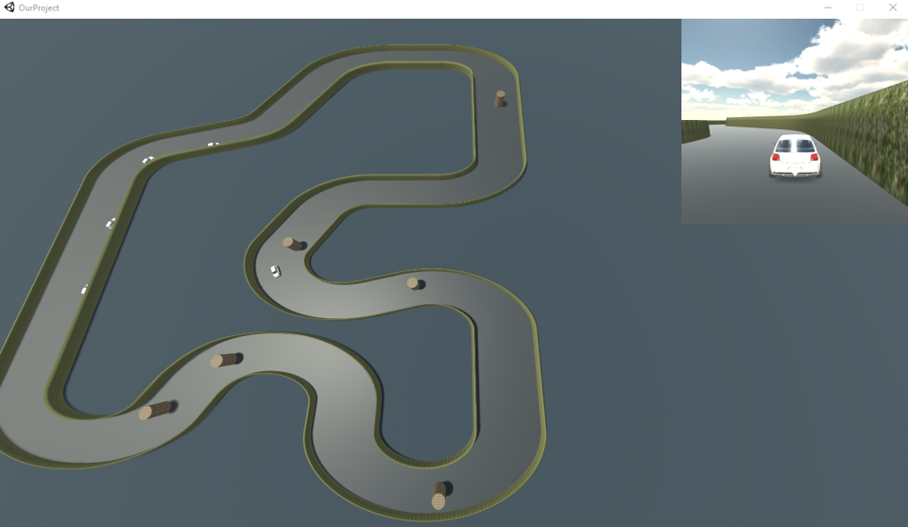


Building Multi Agent RL Baselines in Unity
Shahar Gottlieb and Rotem Levinson, Supervised by Orr Krupnik
Introduction
Reinforcement Learning
Architecture
Introduction
Reinforcement Learning is a branch of machine learning where an agent preforms in an environment and gets rewarded for his action.
The agent goal is to learn a behavior policy that will maximize his reward over time.
Expending RL to solve multi agent problems is field where a lot of research is made.
Multi agent problems involves many agents that learns at the same time, with individual or common reward.
This type of problems raises challenges that don't exist in single agent problems and requires different solutions.
Today, the development and testing environments for multi agent reinforcement learning are scarce, and the existing environments are ill-suited for solving some interesting problems.
State: $s_{t}$
Action: $a_{t}$
Reward: $r_{t}$
Discount: $γ$
Trajectory: $τ=(a_{0}, s_{0}, a_{1}, s_{1},…)$
Policy: $π$
Cumulative Reward:
$$R(τ)=\sum_{t=0}^{∞}{γ^{t}⋅r(}s_{t}, a_{t},s_{t+1})$$
Optimal Policy:
$$π^{∗}=argmax_{π}(E_{τ\left(π\right)}\left[R\left(τ\right)\right])$$
Q function (with bellman equation):
$Q^{∗}\left(s,a\right)=E_{τ\left(π^{∗}\right)}\left[R\left(τ\right)\right|s_{0}=s, a_{0}=a]$
$${=E}_{s^{′}∼P}\left[r\left(s,a\right)+γQ^{∗}\left(s^{′},{a^{′}=π}^{∗}(s^{′})\right)\right]$$
Python -
Abstract agent class – easy to implement any agent algorithm
3 agent for baseline – DDPG, MDDPG. MADDPG
Main – user interface with simple one line command to run any configuration –
Unity –
Graphic – cars, obstacles, race track, camers etc. we design all the objects to look and behave realistic as possible.
ML-agent brain – API to Python. Python code controls the game.
Game Logic – controls the game objects, mainly gets observation and sets rewards to the agents (cars).
Python
Unity build
ML-agent
Brain object
Python wrapper
Test/train
Agent
Wrapper
DDPG
Deep Deterministic Policy Gradient (DDPG)
ml-agent toolkit
MDDPG
Existing Multi Agent RL environments examples
MADDPG
Goals
Unity Graphic engine
Game Logic
(observations and rewards)
Our main goal is to create environment for training and testing multi agents reinforcement learning algorithms.
Main requirements of the environment are:
User friendly – easy to use and to change
Realistic – simulate real life problem
Scalable – can train and test large number of agent
Modular – user can add his own code easily
Performance base line – provide performance baseline for future users to compare.
High level block diagram
$$L\left(θ, D\right)=$$
$$E_{\left(s,a,r,s^{′},d\right)∼D}\left[{\left(Q_{θ}\left(s,a\right)−(r+γ\left(1−d\right)Q_{θ}\left(s^{′},π_{θ}\left(s′\right)\right))\right)}^{2}\right]$$
$$θ^{π}=\max_{θ^{π}}{Q_{θ}(s, π(s))}$$
$$θ^{Q}=\min_{θ^{Q}}{L(θ, D)}$$
Results
Achieved working environment with user command line interface.
Provides trained agents and running examples for future users.
Multi Agent
Cars race
Not stationary
High computational cost
Real life problems
Multi-Agent DDPG Algorithm:
We chose to implement car race environment
Easily scalable, our version supports up to 16 cars
Realistic – self driven cars are hot and interesting problem this days
Cars can benefit from learning policy together (i.e. avoid collisions)
Modular – user can change the track, car setting and obstacles location to generate interesting scenarios.
DDPG and MADDPG training results
Suggested in [Lowe et al., 2017]
Conclusions
Unity 3D
Contributing an open source environment for other researchers to use.
Our environment is User Friendly, Realistic, Scalable and Modular.
Implementations of baseline RL algorithms
Graphic game development tool
Provides real life physics
Provides ML package
Provides API to python
February 2020

